Slide 1
Proxy, Style Component
React.Fragment
Artem Pavliuk

Slide 2
HOC
A higher-order component (HOC) is an advanced technique in React for reusing component logic. HOCs are not part of the React API. They are a pattern that stems from React’s nature that privileges composition over inheritance.
The main purpose of a higher-order component in React is to share common functionality between components without repeating code.
HOCs are common in third-party React libs, such as Redux or React Router. I bet you’ve used some of them, maybe without being aware of it.

Slide 3
HOC
Basically there are two main types of HOC implementation:
Props Proxy
Style Component

Slide 4
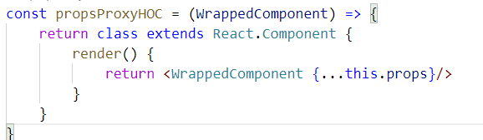
Proxy
Props Proxy HOCs are useful to the following situations:
Manipulating props
Accessing the instance via Refs (be careful, avoid using refs)
Abstracting State
Wrapping/Composing the WrappedComponent with other elements
Notes:
It’s nothing more than a function, propsProxyHOC, that receives a Component as an argument (in this case we’ve called the argument WrappedComponent) and returns a new component with the WrappedComponent within.
Have in mind that when we return the WrappedComponent, we also pass thru the props that the HOC receives. This explains the name given to this type: props proxy.
When we return the Wrapped Component we have the possibility to manipulate props and to abstract state, even passing state as a prop into the Wrapped Component.
You can also wrap the Wrapped Component with other JSX elements changing its UI according to your app needs.

Slide 5
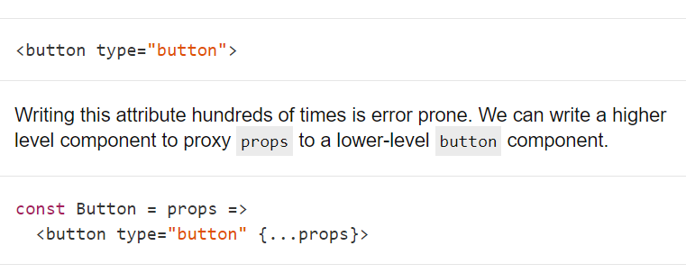
Proxy

Slide 6
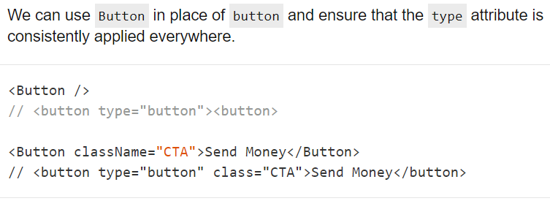
Proxy

Slide 7
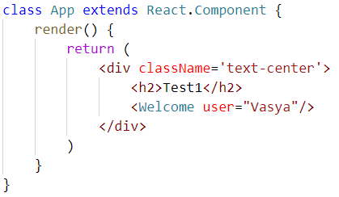
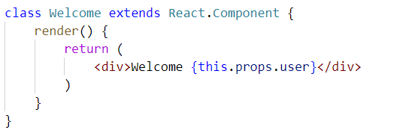
Proxy

Slide 8
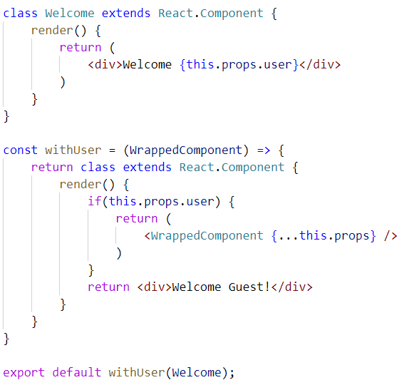
Proxy
Notes:
What if I want the component to return Welcome Guest if no user is logged in?
Well… I can do that in the same Welcome component, with a simple if that checks if the user prop exists and if not it simply returns “Welcome Guest”.
But let’s suppose I want to encapsulate that logic to use with multiple / different Welcome Components.
So the way to go is to make a Props Proxy HOC:
What have we done here? We kept our Welcome component simple and we’ve created a JavaScript function called withUser which gets the Welcome component (WrappedComponent) as an argument and checks if the prop user exists. If it doesn’t it just returns a simple “Welcome Guest!” message.
This is very useful. Imagine you had 30 Welcome components in different languages (silly example but it makes the point of encapsulating the logic into a HOC).
Nice, so now we have a HOC to check if there’s a user logged in, otherwise it throws a Welcome Guest Message!

Slide 9
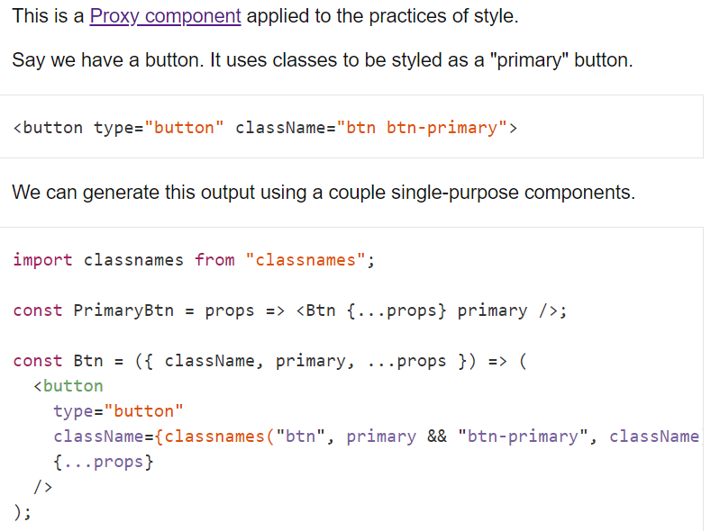
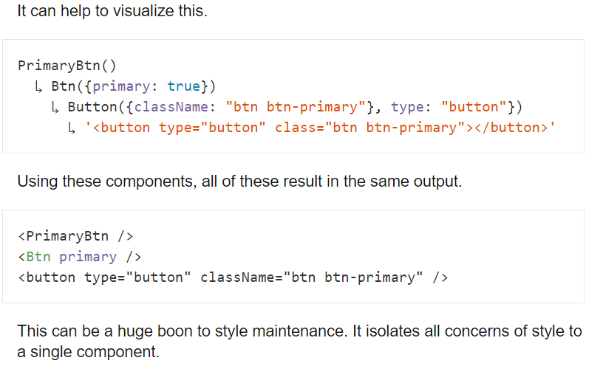
Style Component

Slide 10
Links
https://reactpatterns.com/

Slide 11
Thank you
Artem Pavliuk

